Slide 1
Provision an Azure Synapse Analytics workspace
Open the Azure portal at https://portal.azure.com, and sign in using the credentials associated with your Azure subscription.
In the Azure portal, on the Home page, use the ＋ Create a resource icon to create a new resource.
Search for Azure Synapse Analytics, and create a new Azure Synapse Analytics resource with the following settings.
Resource group: Create a new resource group with a suitable name, like “rocs-rg”
Managed resource group: Enter an appropriate name, for example “synapse-managed-rg”.
Workspace name: *Enter a unique workspace name, for example “tiwariji.
Region: Select any of the following regions: - East –US
Select Data Lake Storage Gen 2: From subscription.
Account name: *Create a new account with a unique name, for example “datalake"*.
File system name: *Create a new file system with a unique name, for example “fs"*.
When you’ve entered these details, select Review + create, and then select Create to create the workspace.

Slide 2
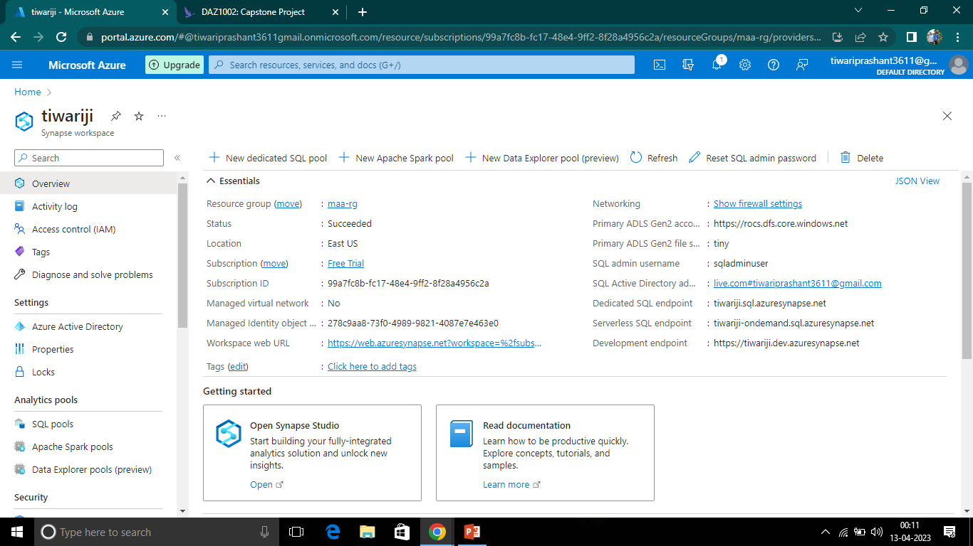

Slide 3
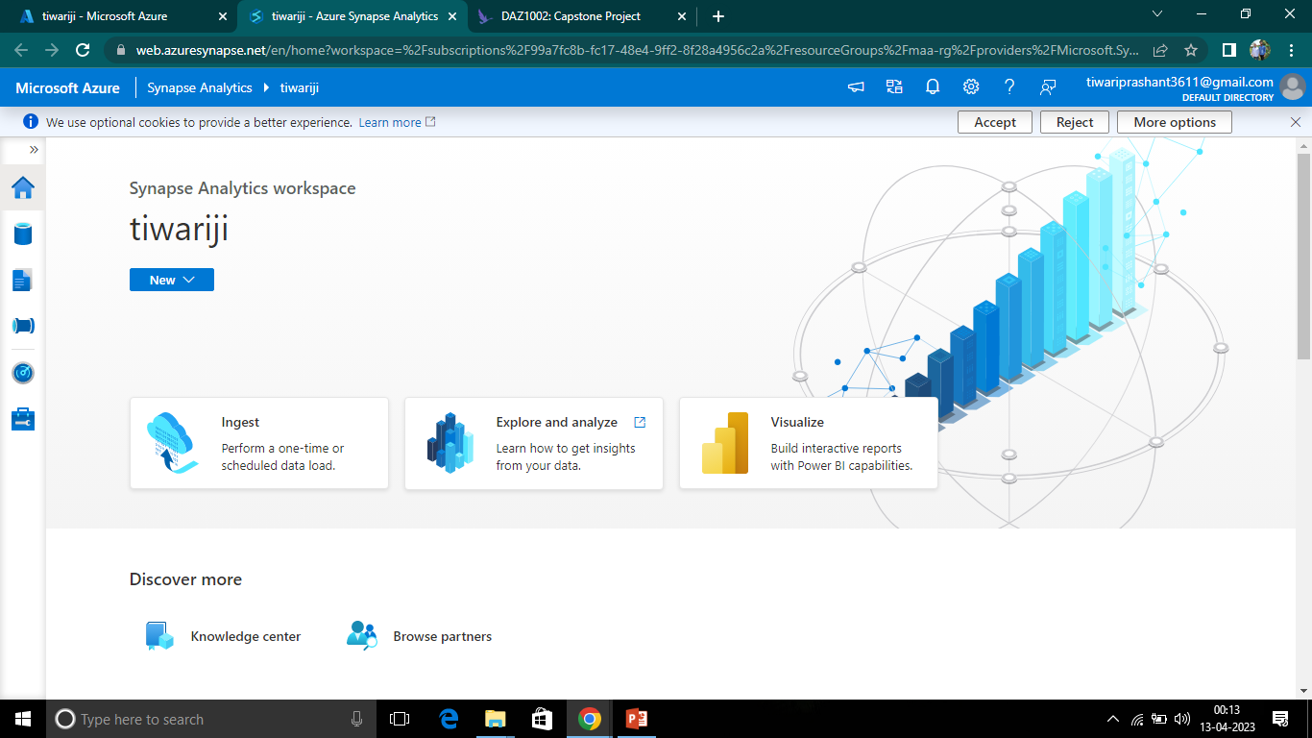

Slide 4
Ingest a Data
In Synapse Studio, on the Home page, select Ingest to open the Copy Data tool tool.
In the Copy Data tool, on the Properties step, ensure that Built-in copy task and Run once now are selected, and click Next >
On the Source step, in the Dataset substep, select the following settings:
Source type: All
Connection: Create a new connection, and in the New connection pane that appears, on the File tab, select HTTP. Then continue and create a connection to a data file using the following settings:
Name: AdventureWorks Products
Description: Product list via HTTP
Connect via integration runtime: AutoResolveIntegrationRuntime
Base URL:
https://raw.githubusercontent.com/MicrosoftLearning/DP-900T00A-Azure-Data- Fundamentals/master/Azure-Synapse/products.csv
Server Certificate Validation: Enable
Authentication type: Anonymous
4. After creating the connection, on the Source/Dataset substep, ensure the following settings are selected, and then select Next >:

Slide 5
Relative URL: Leave blank
Request method: GET
Additional headers: Leave blank
Binary copy: Unselected
Request timeout: Leave blank
Max concurrent connections: Leave blank
5. On the Source step, in the Configuration substep, select Preview data to see a preview of the product data your pipeline will ingest, then close the preview.
6. After previewing the data, on the Source/Configuration step, ensure the following settings are selected, and then select Next >
File format: DelimitedText
Column delimiter: Comma (,)
Row delimiter: Line feed (\n)
First row as header: Selected
Compression type: None
7. On the Destination step, in the Dataset substep, select the following settings:
Destination type: Azure Data Lake Storage Gen 2
Connection: Select the existing connection to your data lake store (this was created for you when you created the workspace).

Slide 6
8. After selecting the connection, on the Destination/Dataset step, ensure the following settings are selected, and then select Next >: Folder path: Browse to your file system folder File name: products.csv Copy behavior: None Max concurrent connections: Leave blank Block size (MB): Leave blank
9. On the Destination step, in the Configuration substep, ensure that the following properties are selected. Then select Next >:
File format: DelimitedText
Column delimiter: Comma (,)
Row delimiter: Line feed (\n)
Add header to file: Selected
Compression type: None
Max rows per file: Leave blank
File name prefix: Leave blank
10.On the Settings step, enter the following settings and then click Next >:
Task name: Copy products
Task description Copy products data
Fault tolerance: Leave blank
Enable logging: Unselected
Enable staging: Unselected

Slide 7
11.On the Review and finish step, on the Review substep, read the summary and then click Next >.
12.On the Deployment substep, wait for the pipeline to be deployed and then click Finish.
13.In Synapse Studio, select the Monitor page, and in the Pipeline runs tab, wait for the Copy products pipeline to complete with a status of Succeeded (you can use the ↻ Refresh button on the Pipeline runs page to refresh the status).
14.On the Data page, select the Linked tab and expand the Azure Data Lake Storage Gen 2 hierarchy until you see the file storage for your Synapse workspace. Then select the file storage to verify that a file named products.csv has been copied to this location, as shown here:

Slide 8
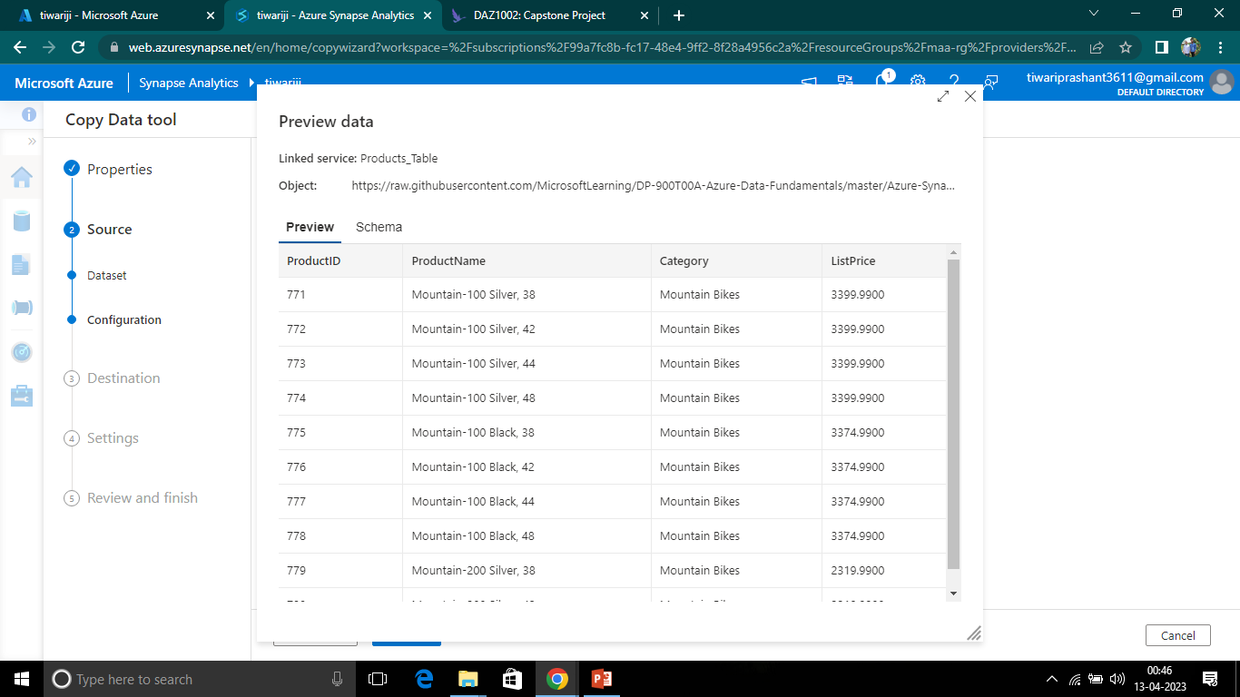

Slide 9
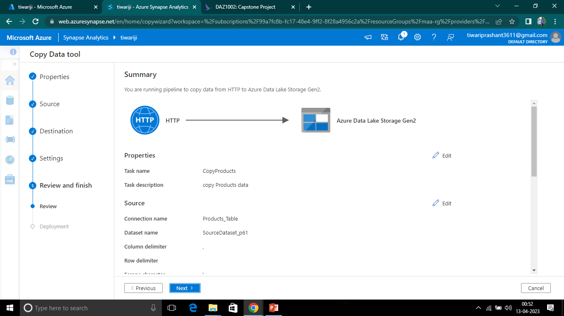

Slide 10
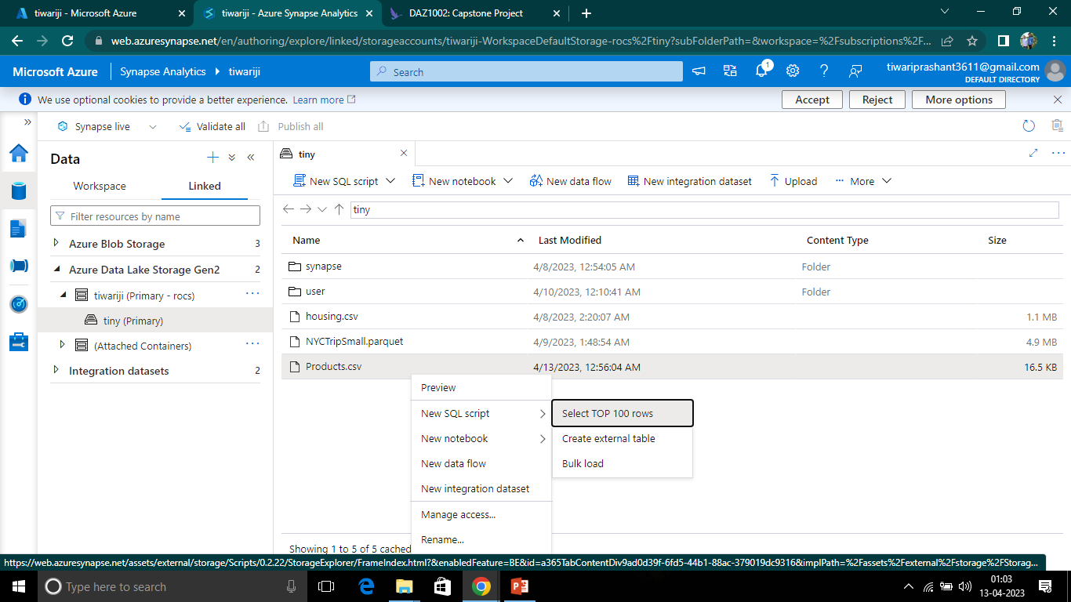
SQL –Pool to analyse a Data

Slide 11
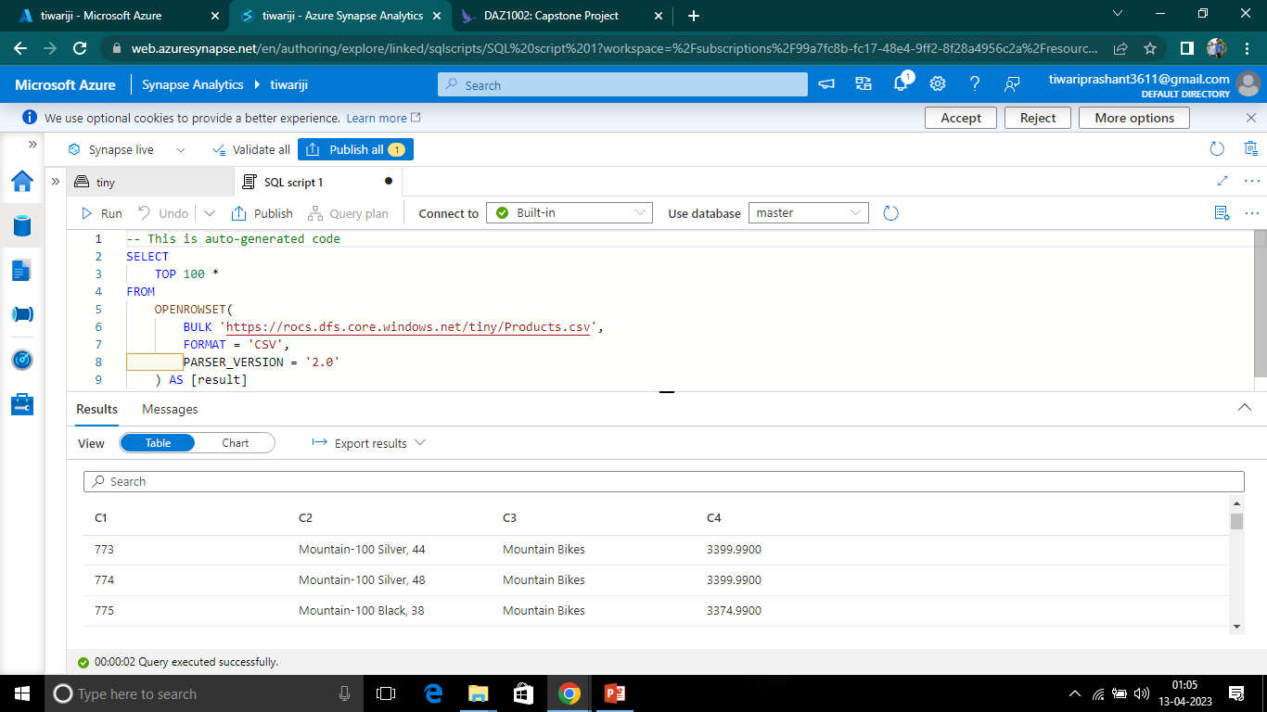

Slide 12
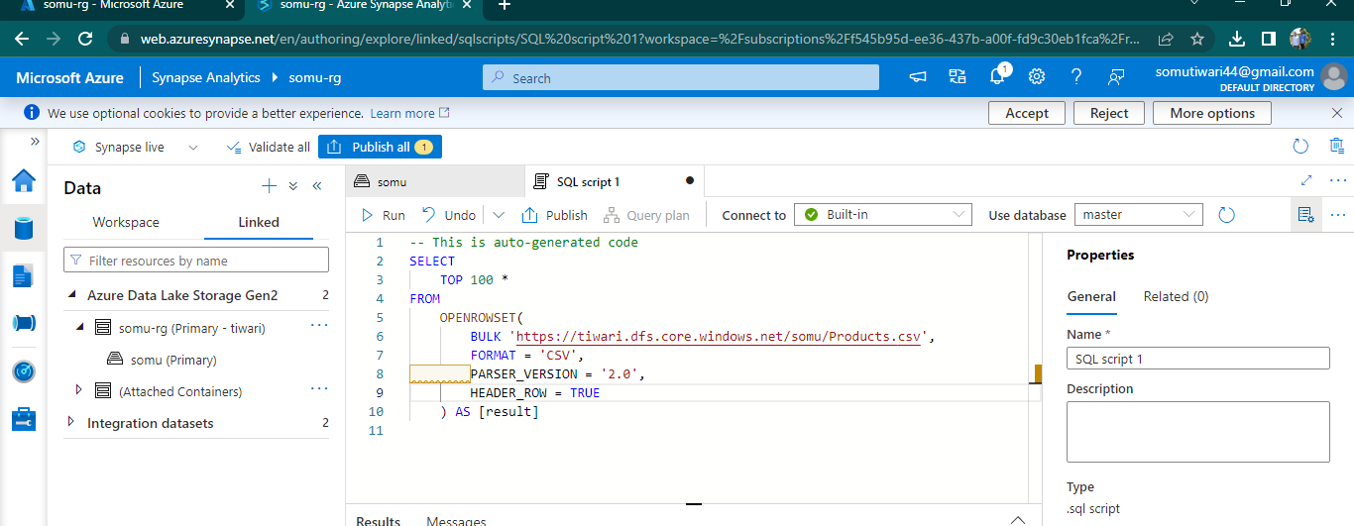
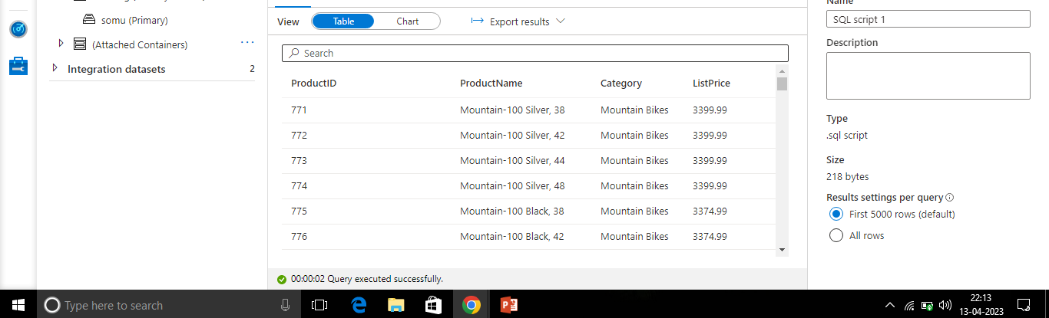

Slide 13
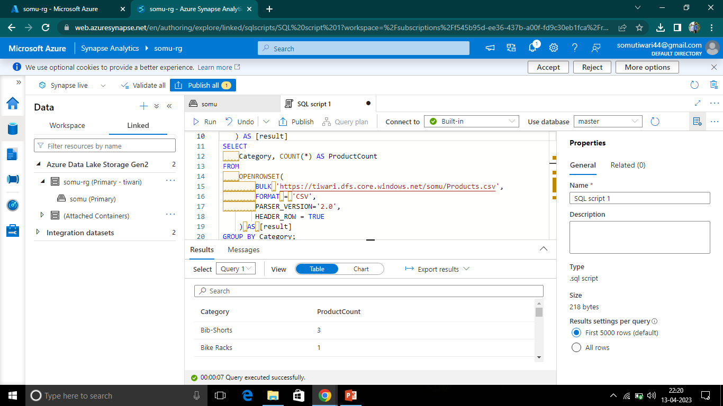

Slide 14
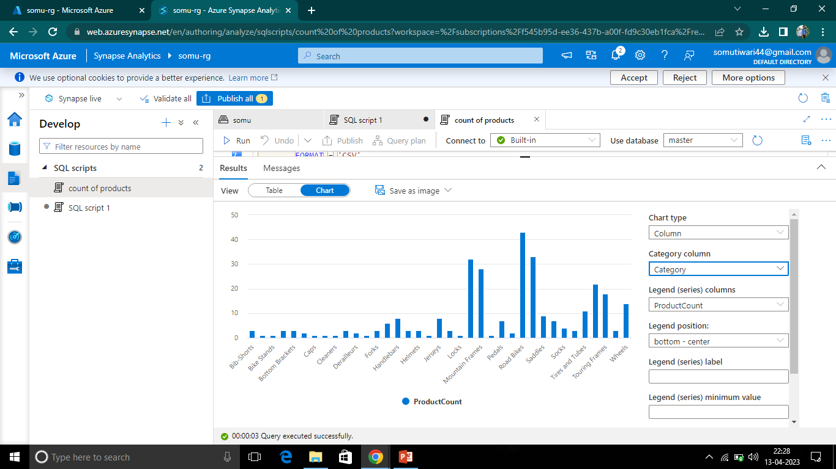

Slide 15
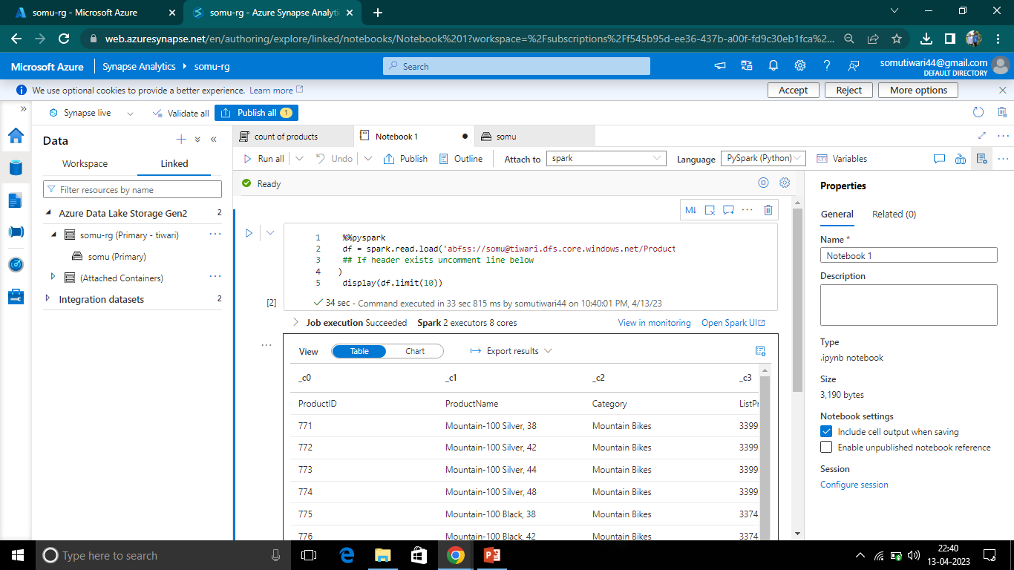

Slide 16
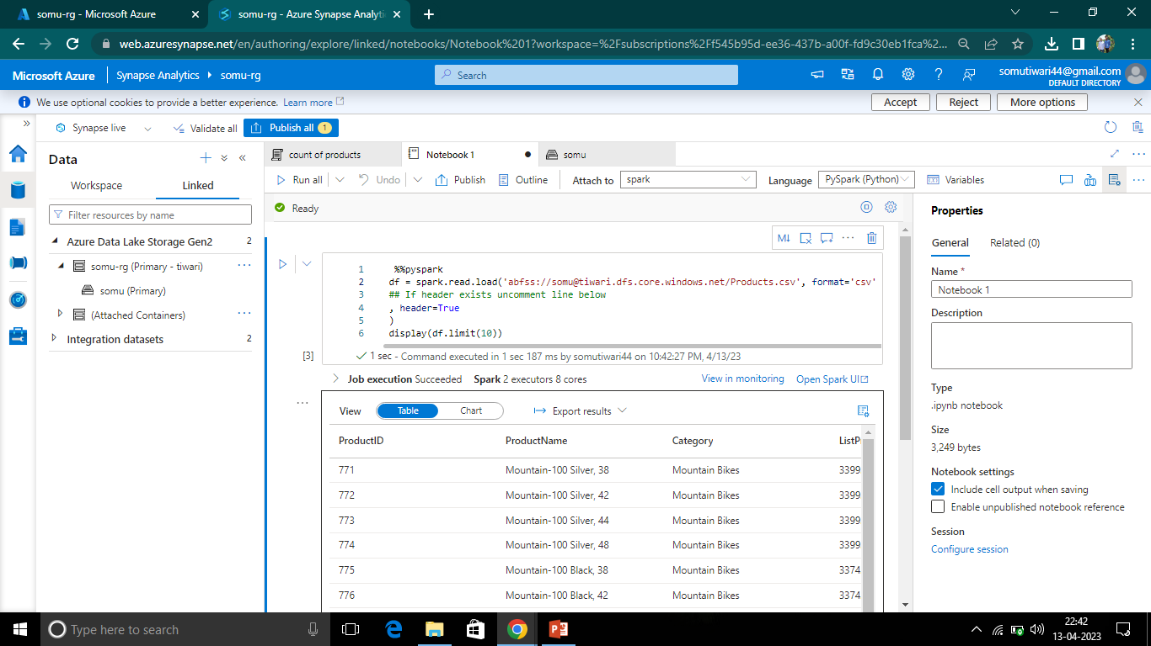

Slide 18
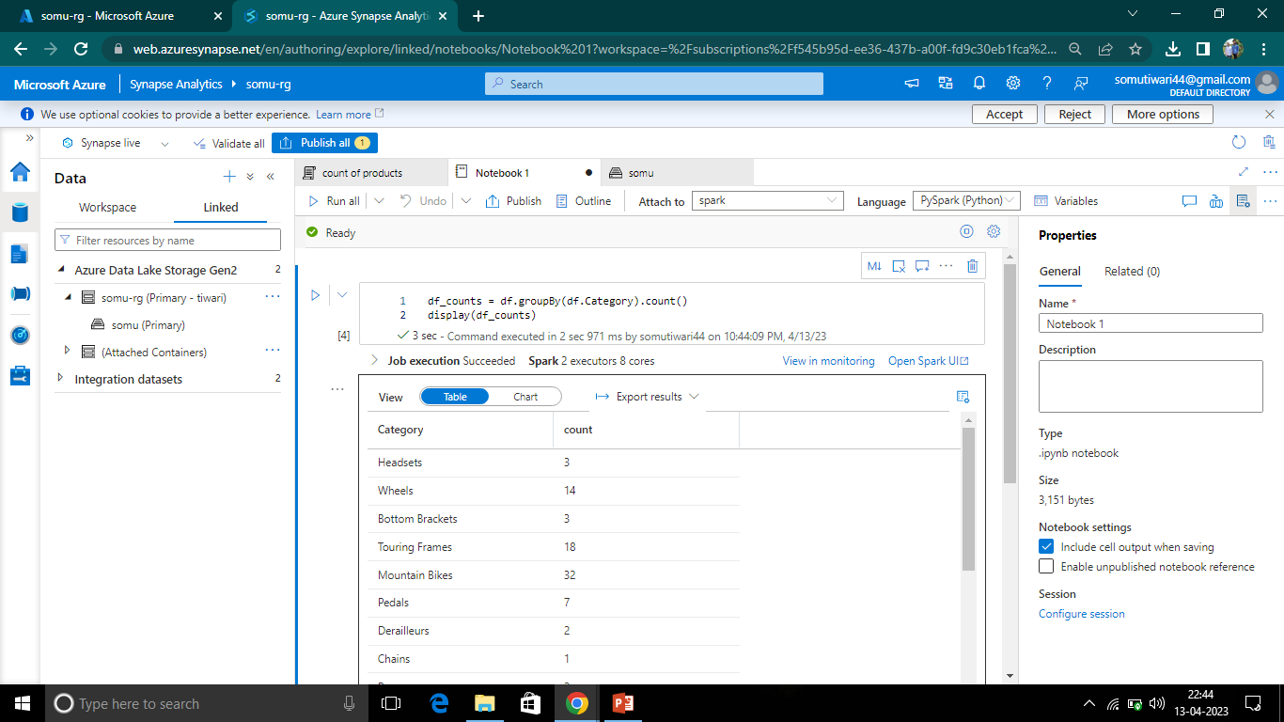

Slide 20
Delete Resource Group
Close the Synapse Studio browser tab and return to the Azure portal.
On the Azure portal, on the Home page, select Resource groups.
Select the resource group for your Synapse Analytics workspace (not the managed resource group), and verify that it contains the Synapse workspace, storage account, and Spark pool for your workspace.
At the top of the Overview page for your resource group, select Delete resource group.
Enter the resource group name to confirm you want to delete it, and select Delete.

